Slide 1
Last Class
Chris Piech
CS 106B
Lecture 25
Mar 11, 2016

Slide 2

Today’s Goal
Know where you came from
Show you where you could go

Slide 3
Final notes

Slide 4
Final Exam
Short answer question
Class
Implementation
Recursion
Linear Structures +
Hashing
Trees
Graphs
Challenge Question

Slide 5
Practice Exam 1
Short answer question
Class
Implementation
Recursion
Linear Structures +
Hashing
Trees
Graphs
Challenge Question

Slide 6
Practice Exam 2
Short answer question
Class
Implement-
ation
Recursion
Trees
Graphs
Challenge Question

Slide 7
Practice Exam Sitting
Hewlett 200,
Saturday, March/12,
11am-2pm.

Slide 8
Extra Office Hours
Today,
3pm-4:30pm
Conceptual

Slide 9
Leave a review on Axess

Slide 10
CS 106B Montage

Slide 11
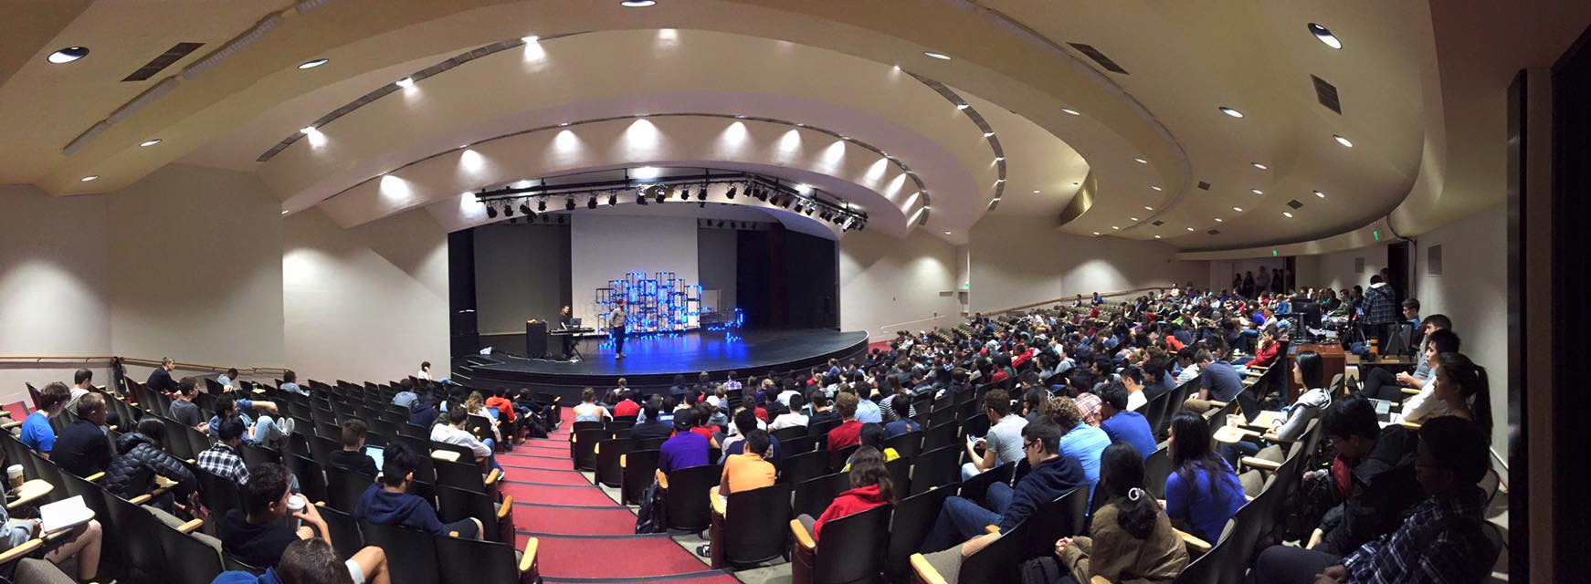
First Day of Class

Slide 12
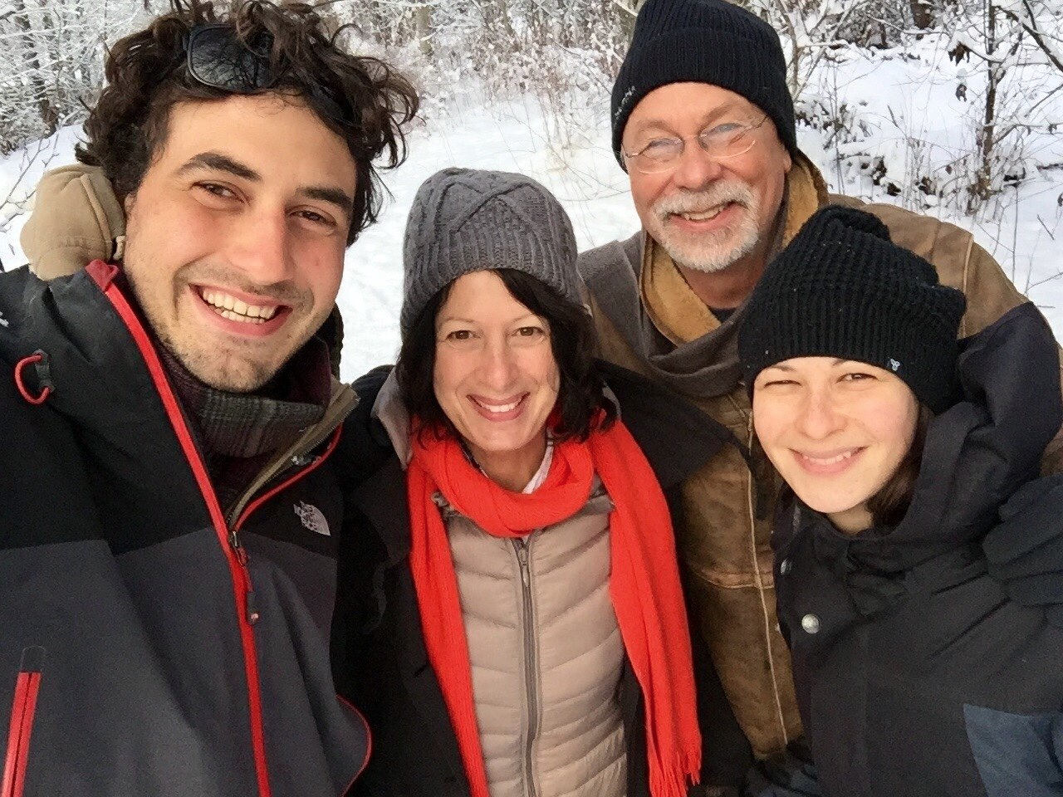
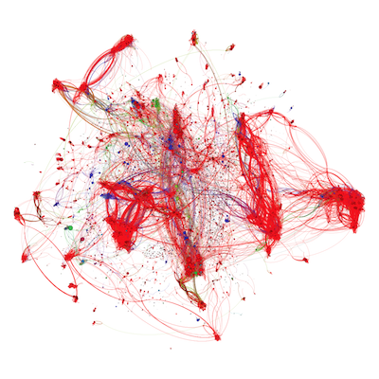

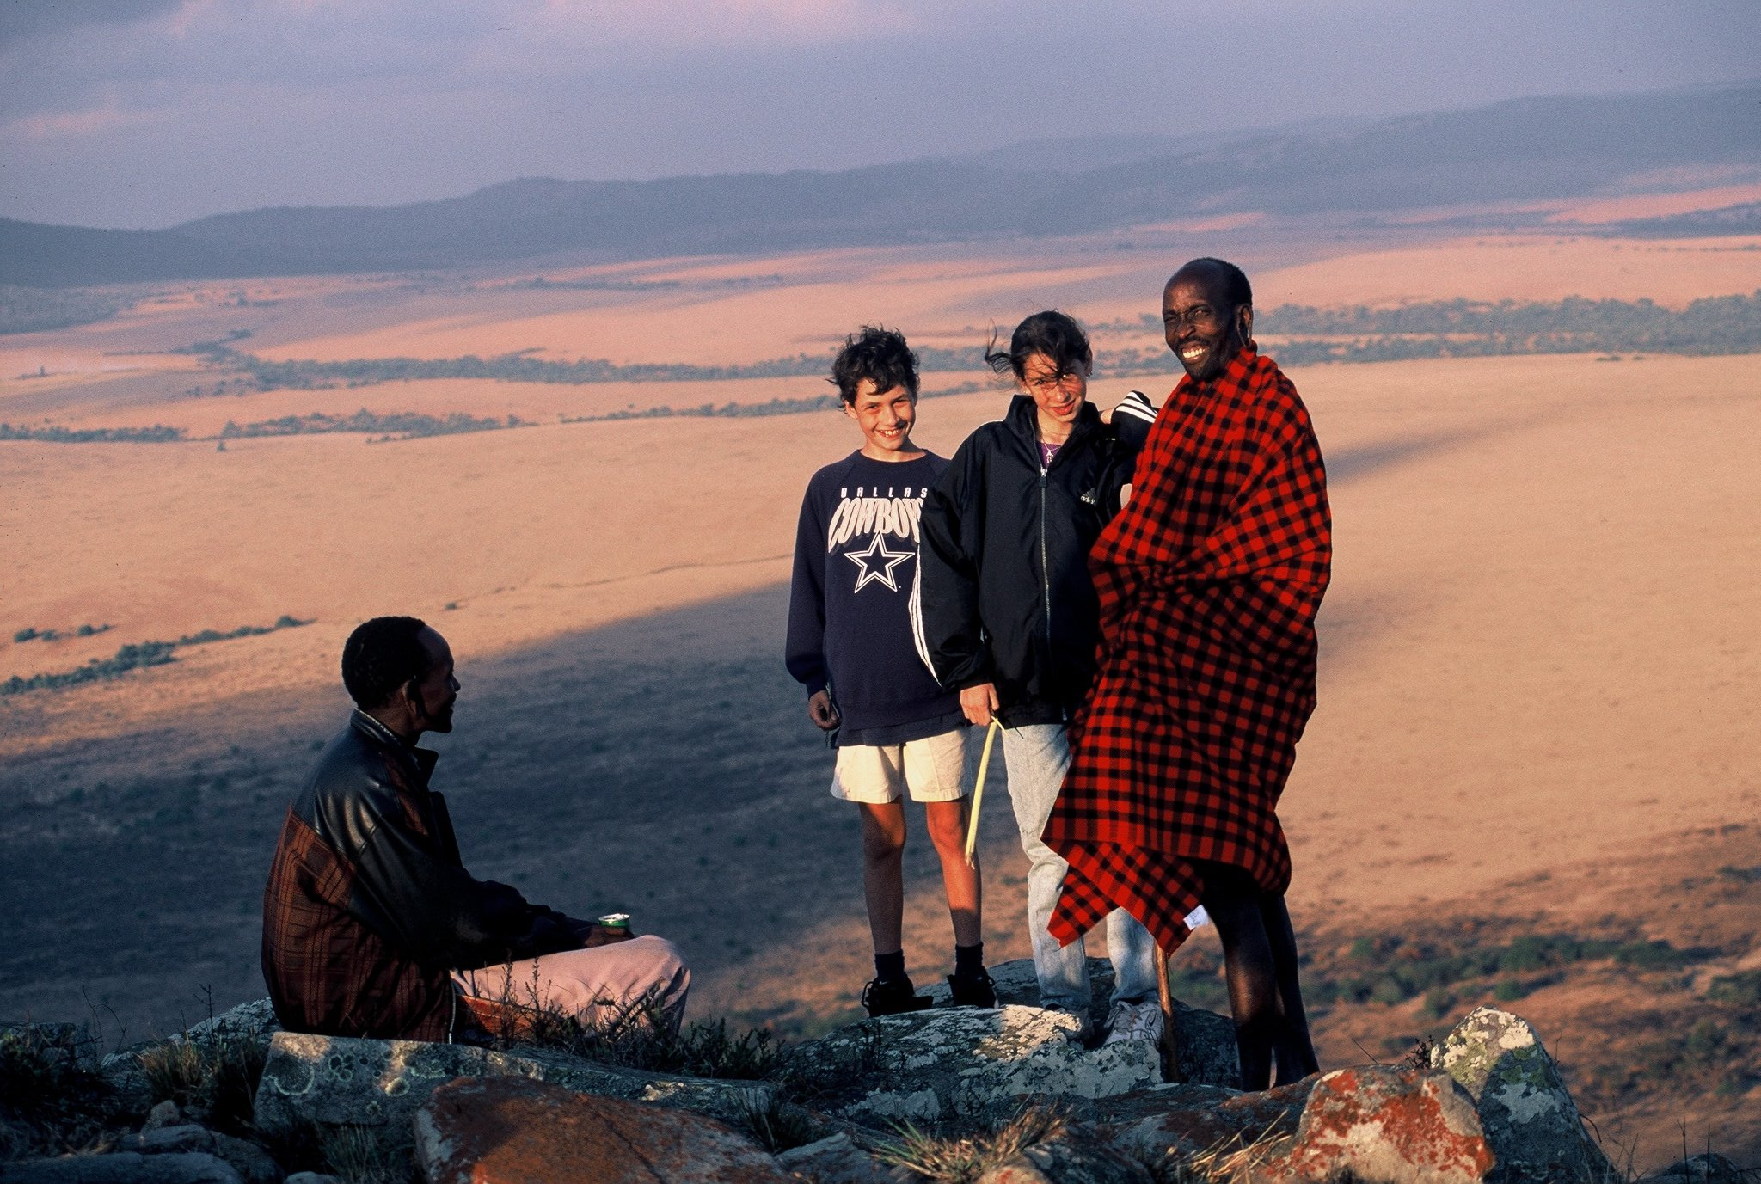
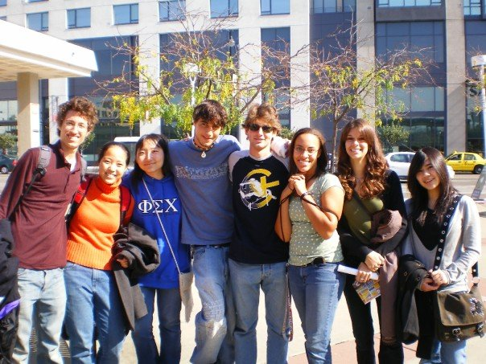
Hi, I’m Chris
Chris Piech (piech@cs.stanford.edu)

Slide 13
Who are You?
African Studies
Applied Physics
Bioengineering
Biology
Business Administration
Chemical Engineering
Chemistry
Classics
Civil and Environmental Engineering
Computational and Mathematical Engineering
Computer Science
Creative Writing
East Asian Studies
Economics
Education
Electrical Engineering
Energy Resource Engineering
English
Financial Mathematics
Film and Media Studies
French
History
International Relations
Japanese
Law
Materials Science and Engineering
Mathematical and Computational Sciences
Mathematics
Mechanical Engineering
Medicine
Management Science and Engineering
Modern Language
Music
Neuroscience
Physics
Political Science
Psychology
Science, Technology, and Society
Statistics
Symbolic Systems
Undeclared!

Slide 14
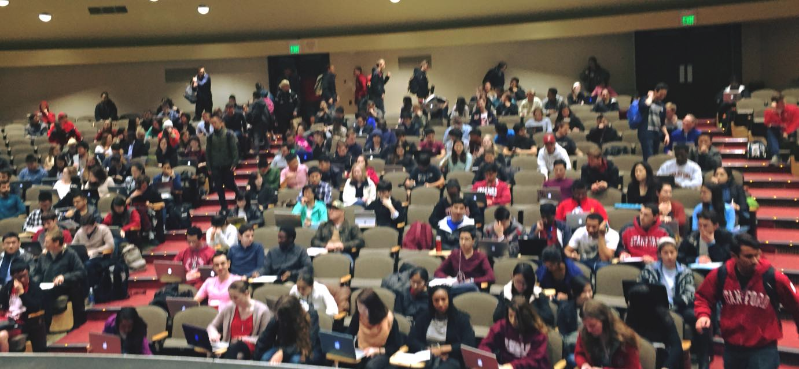

Class Two

Slide 15
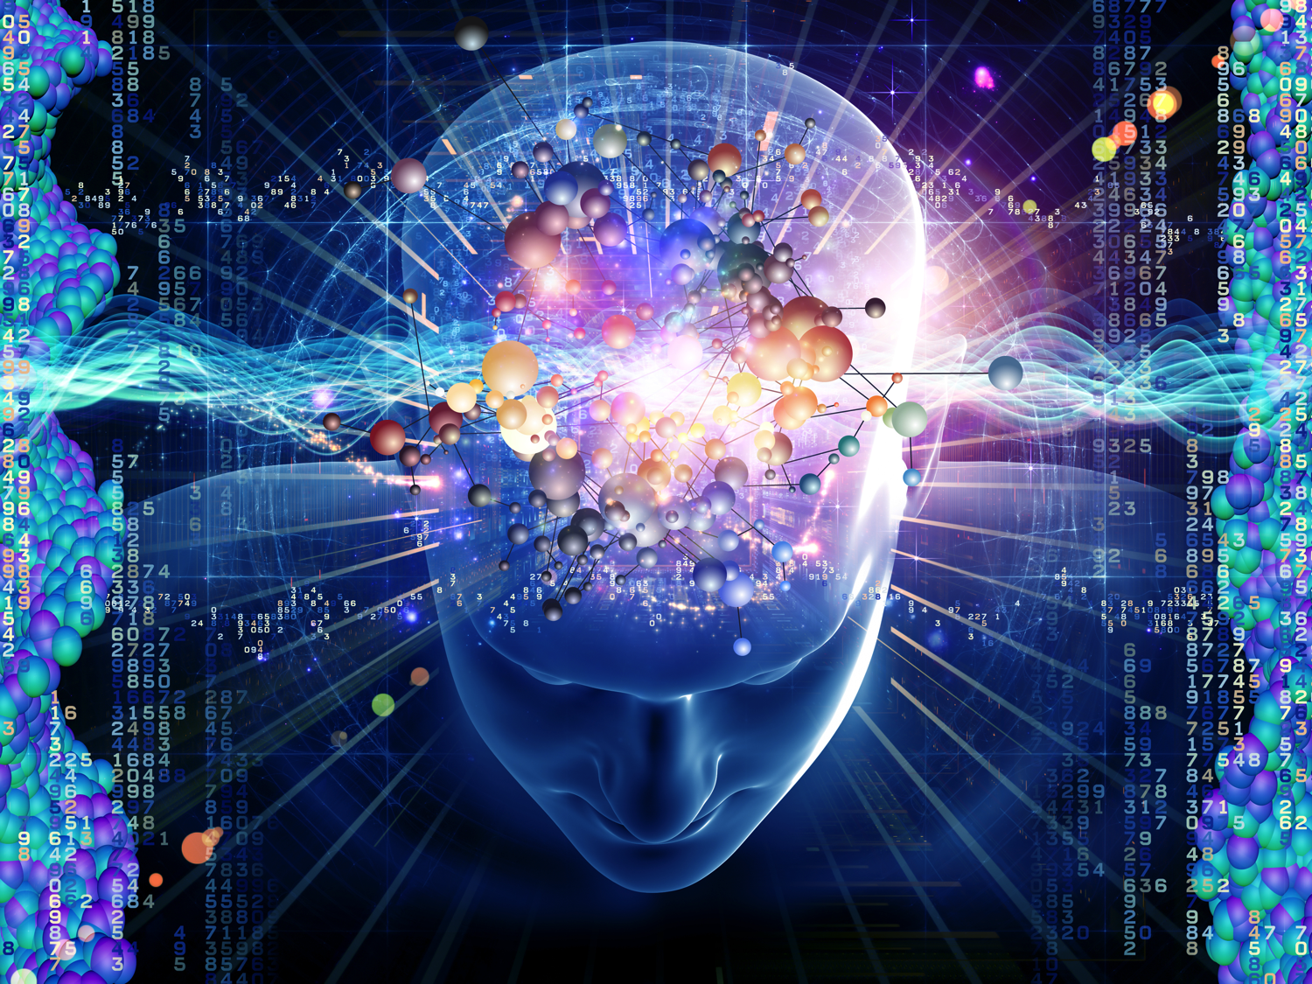
Functions and Parameters
1
2
1
3
6
0.99
-2
0
1
1

Slide 16
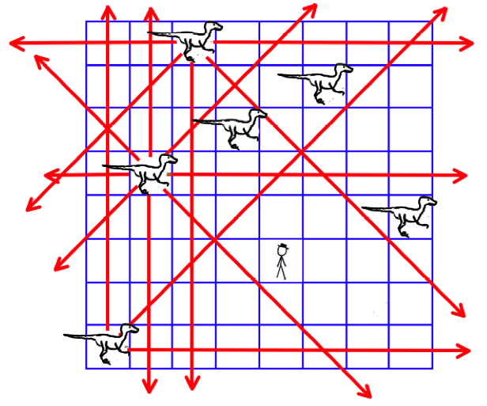
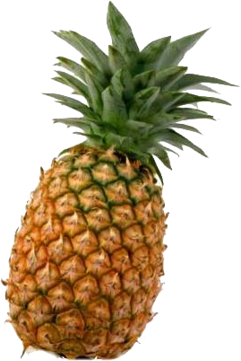
Velociraptor Safety

Slide 17
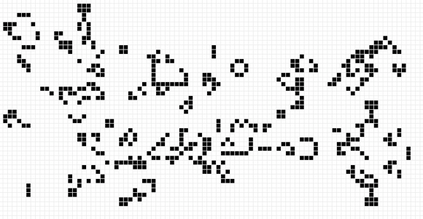
Life

Slide 18
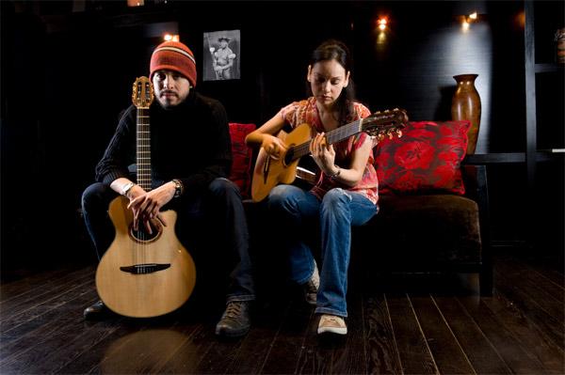

Karplus Algorithm: Sample
1. Average these two numbers and enqueue the result * 0.997
…
0.01
0.16
0.31
0.45
0.58
Front of the queue

Slide 19
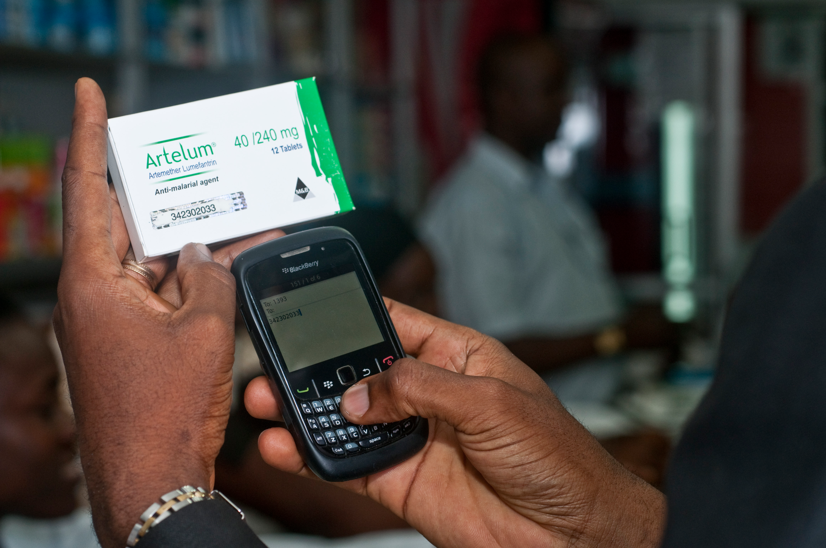
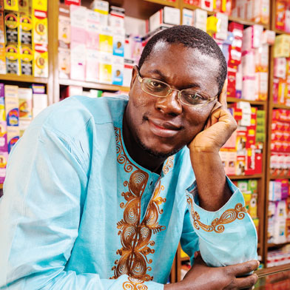
M Pedigree
Bright Simons

Slide 20
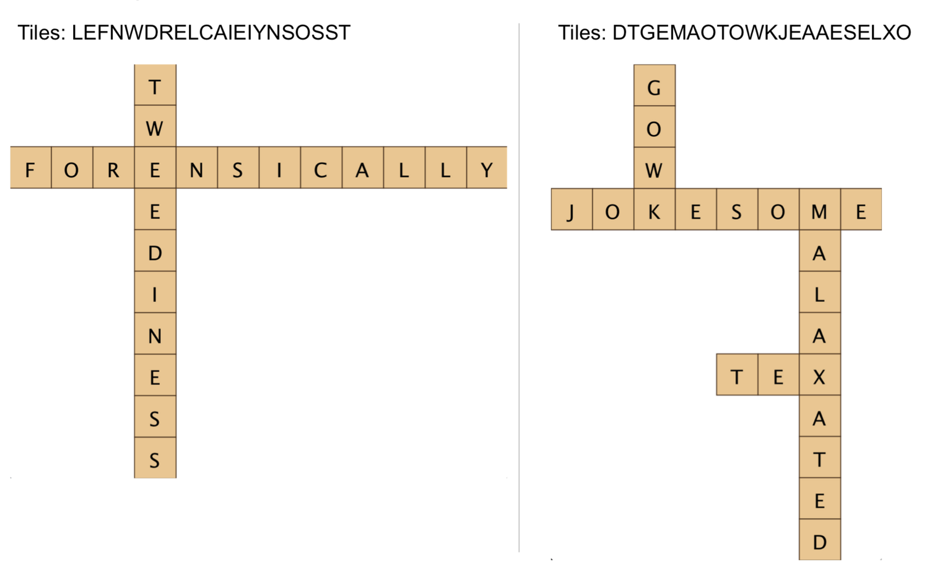
First Ever Banangrams

Slide 21
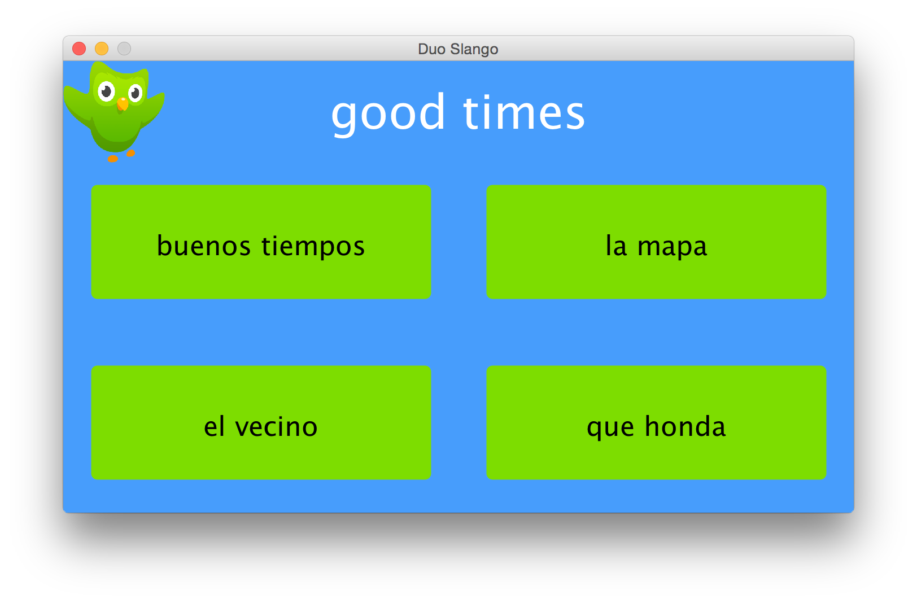
Duolingo
Good, solid review and a new great idea.

Slide 22
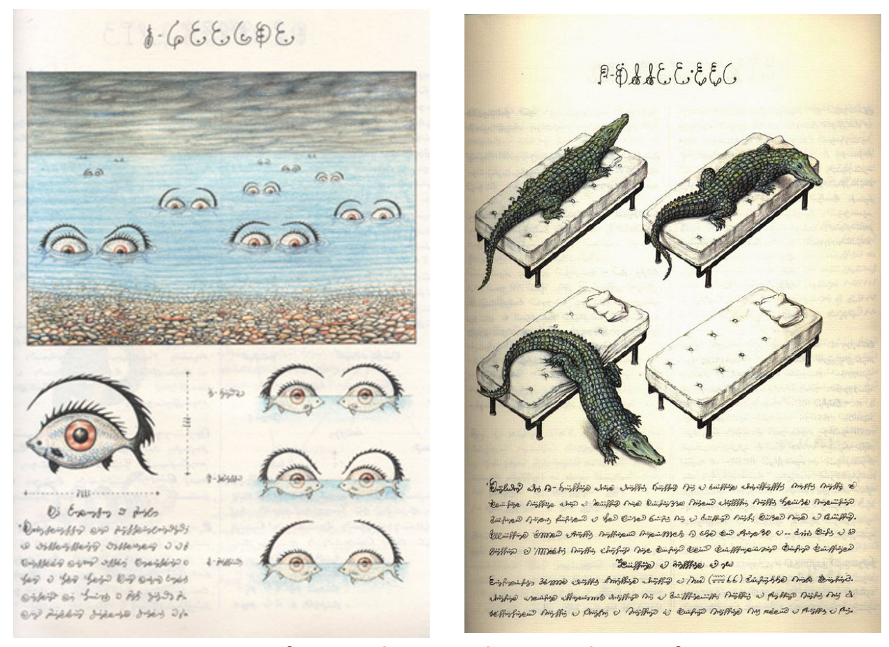
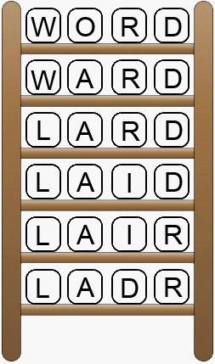
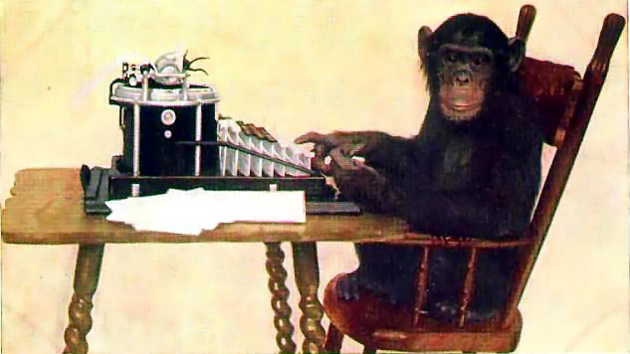
Serafini

Slide 23

Towers of Hanoi

Slide 24
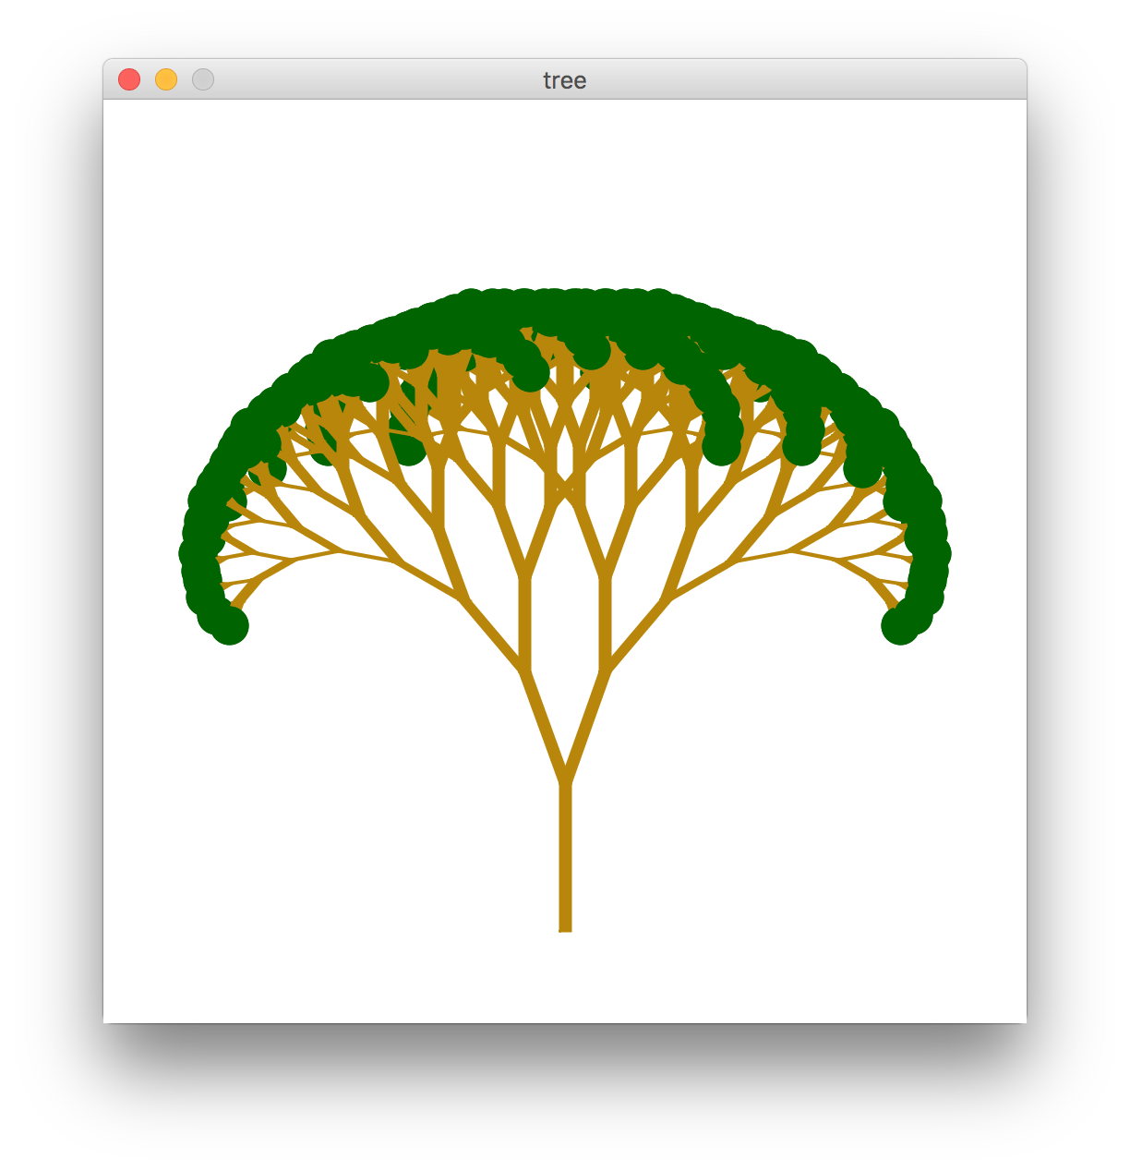
Pythagoreas Tree

Slide 25

Meta Academy

Slide 26
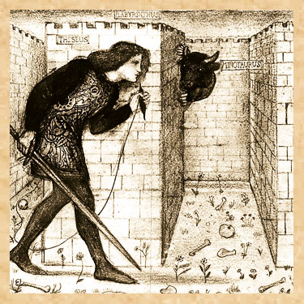
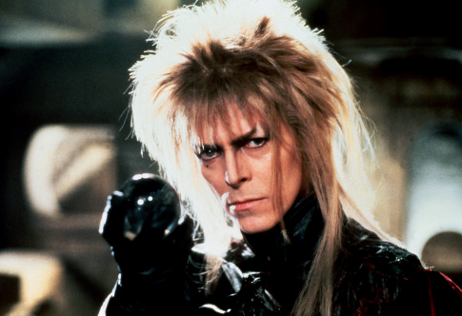
Labyrinth

Slide 27
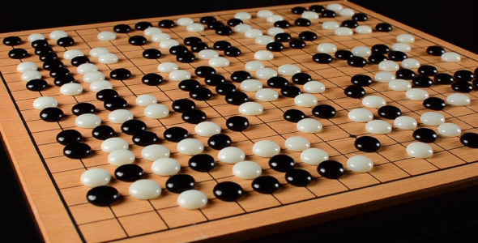
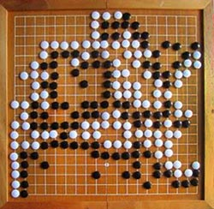
Alpha Go
Only search moves
that the policy network
says are good
When you get deep.
stop. Use value
network to eval.

Slide 28

DNA Alignment
GAATTC
GATTA
Match
Score += 0
Gap s2
Score += 1
Gap s1
Score += 1
AATTC
ATTA
AATTC
GATTA
GAATTC
ATTA
Match
Score += 1
Gap s1
Score += 1
Gap s2
Score += 1
AATTC
TTA
GAATTC
TA
AATTC
ATTA

Slide 29

Boggle

Slide 30
Midterm

Slide 31
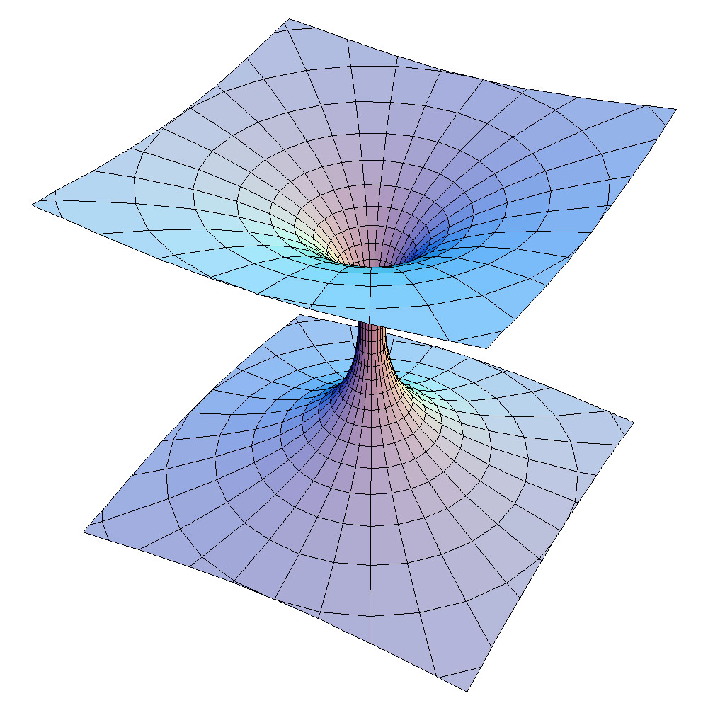

Midterm
Santa
Megan
Mehran
Rudolf
Chris
Get them back on Wednesday
Tell us your favorite song and we’ll create a station that explores that part of the music universe.
Enter Song
Create

Slide 32
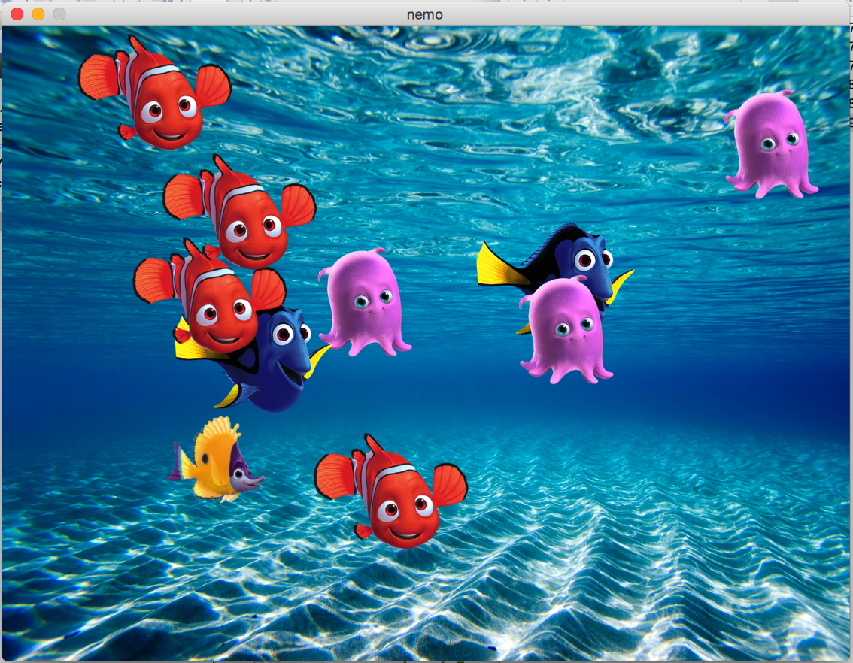
Pointers + Class Example

Slide 33

Beacons of Gondor
Min-Rimmon
Eilenach
Halifirien
Minas Tirith
Amon Dîn
Nardol
Erelas
Calenhad
Rohan
// add a new tower
Tower * temp = new Tower;
temp->name = towerName;
temp->link = head;
head = temp;

Slide 34
Implemented Collections
push(6);
int *
data
8
9
7
6

Slide 35
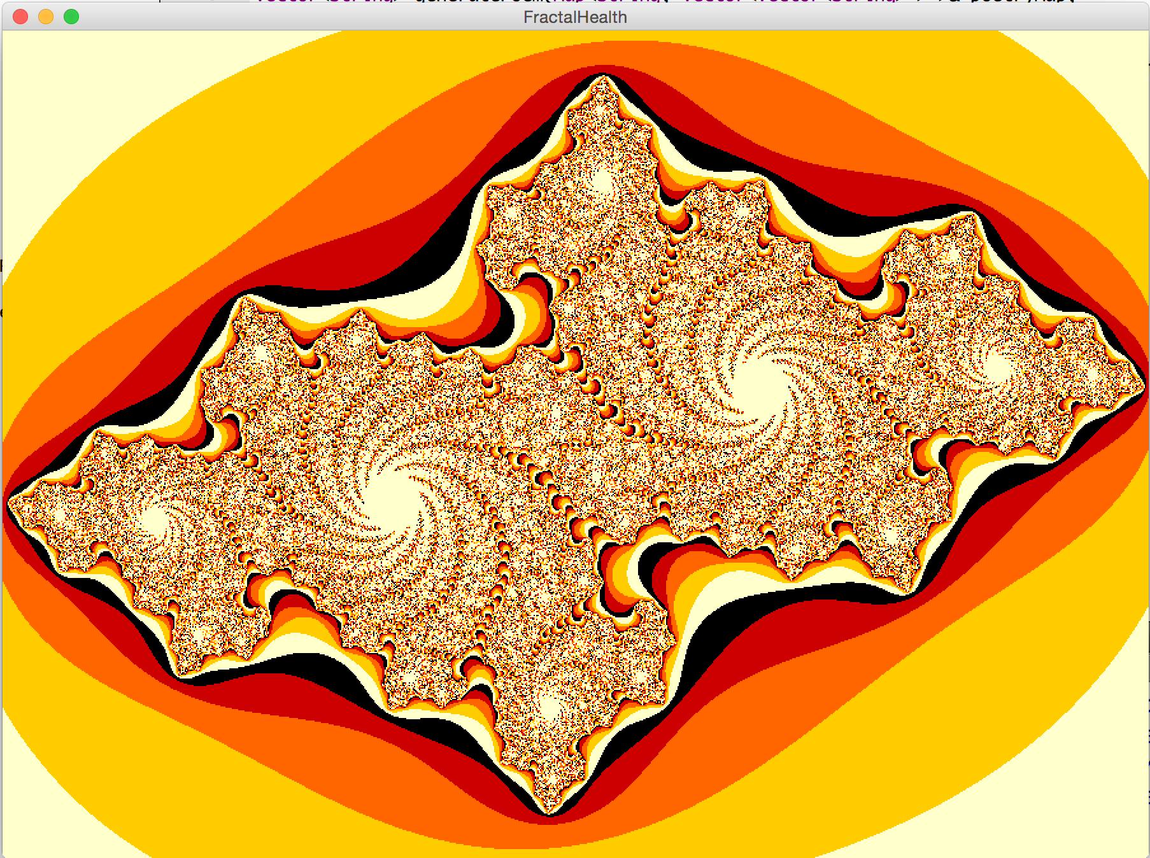
Contest Winner: Creativity
Michelle Park

Slide 36
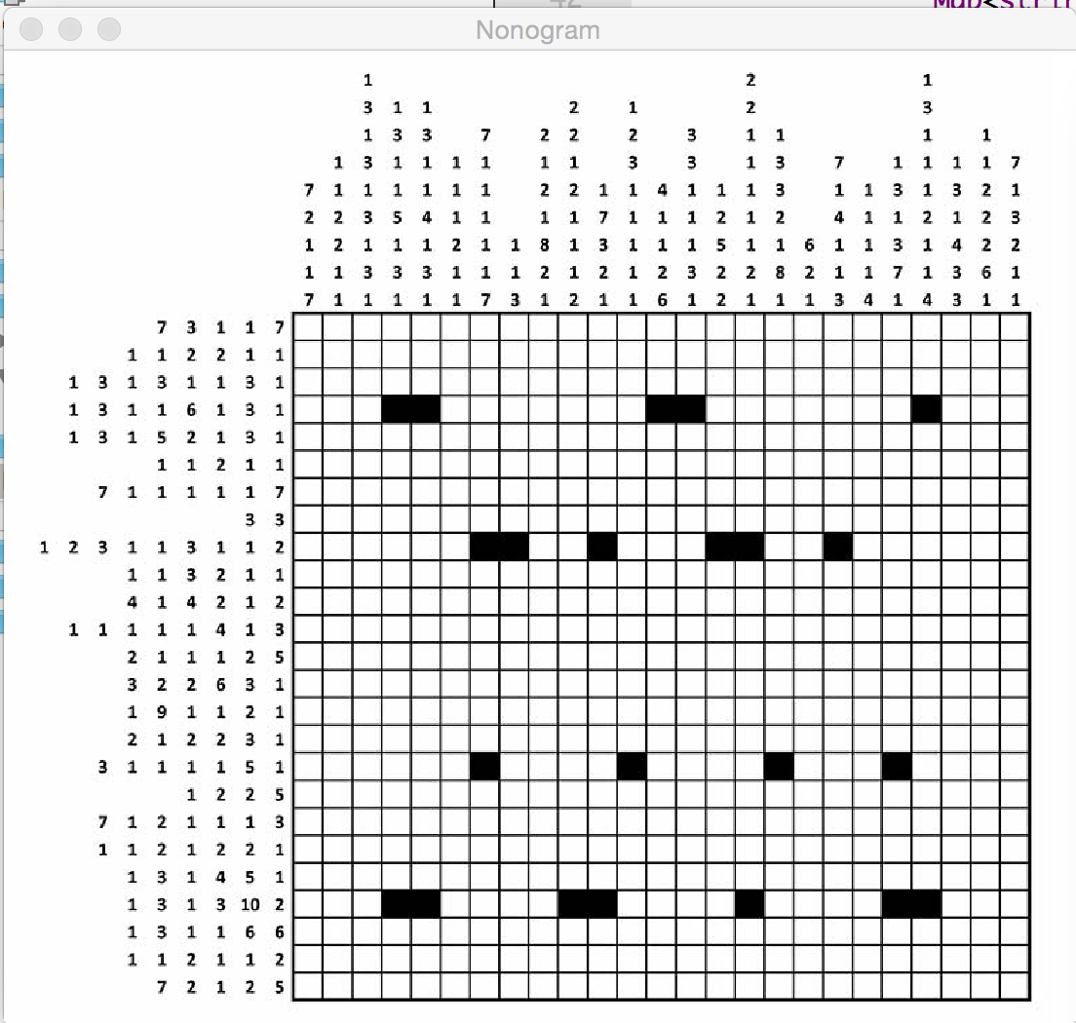
Contest Winner: Algorithmic
Ali Malik

Slide 37

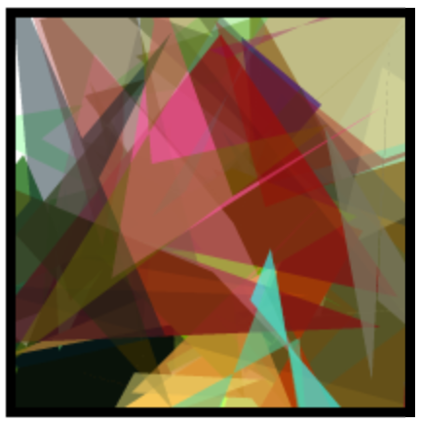
Evolving Art
Species * parent1
Species * parent2
010101111101110110101
110100110011001010110
010101111001100110101

Slide 38
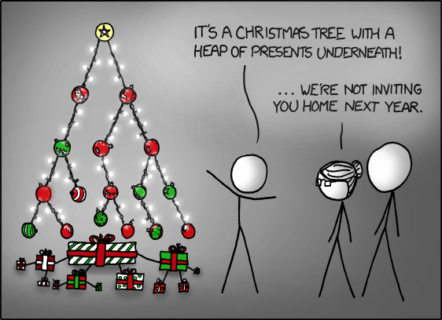

CS 106B, Lecture 17 Priority Queues; Heaps
Priority Queue
reading:
Programming Abstractions in C++, section 16.5

Slide 39

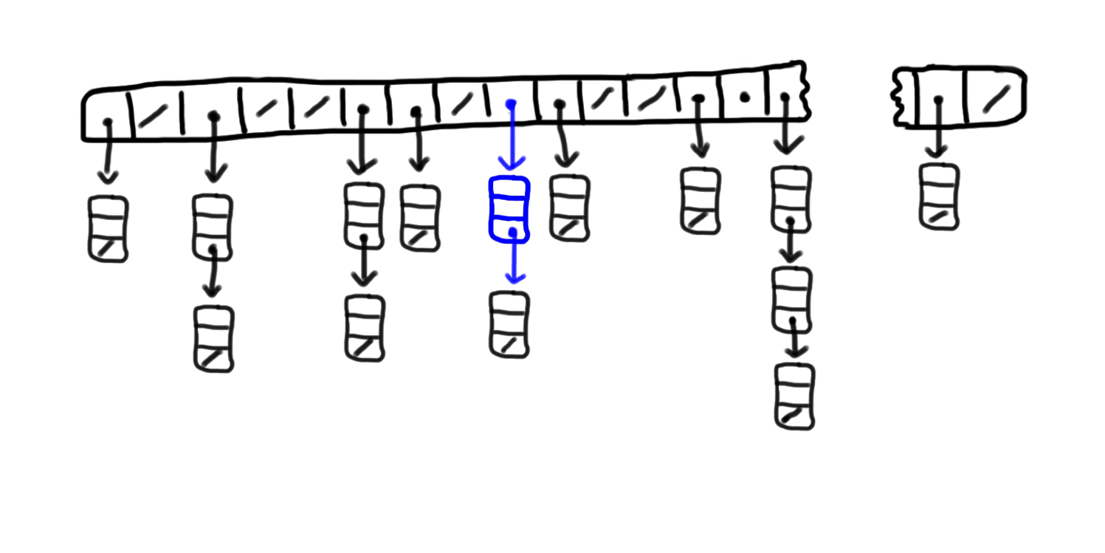

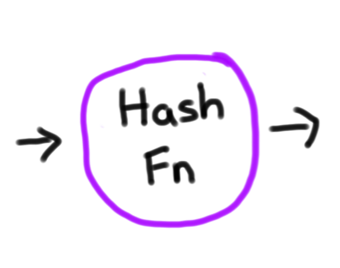

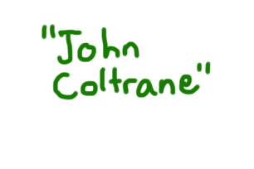
put(“John Coltrane”, html)
Wikipedia:
7
8
9
10
11
12
13
14
49,999
0
1
2
3
4
5
6

Slide 40



Hash-Zam
Source: Shazam

Slide 41
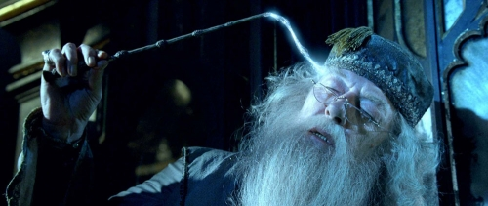
Pensive
Singer?
no
yes
Beyonce
Fruit?
no
yes
DJ Khaled
Apple

Slide 42
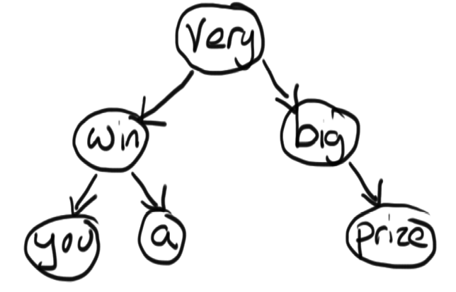
Game Show Tree
void doorOne(Tree * tree) {
if(tree == NULL) return;
cout<<tree->value<<” “;
doorOne(tree->left);
doorOne(tree->right);
}
void doorTwo(Tree * tree) {
if(tree == NULL) return;
doorTwo(tree->left);
cout<<tree->value<<” “;
doorTwo(tree->right);
}
Void doorThree(Tree * tree) {
if(tree == NULL) return;
doorThree(tree->left);
doorThree(tree->right);
cout<<tree->value<<” “;
}

Slide 43
Binary Search Tree for Wikipedia
Searching for the value 31 from the root
root
18
35
22
31

Slide 44

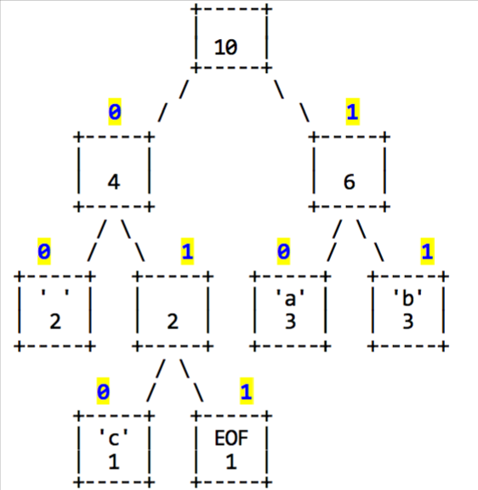
Huffman

Slide 45
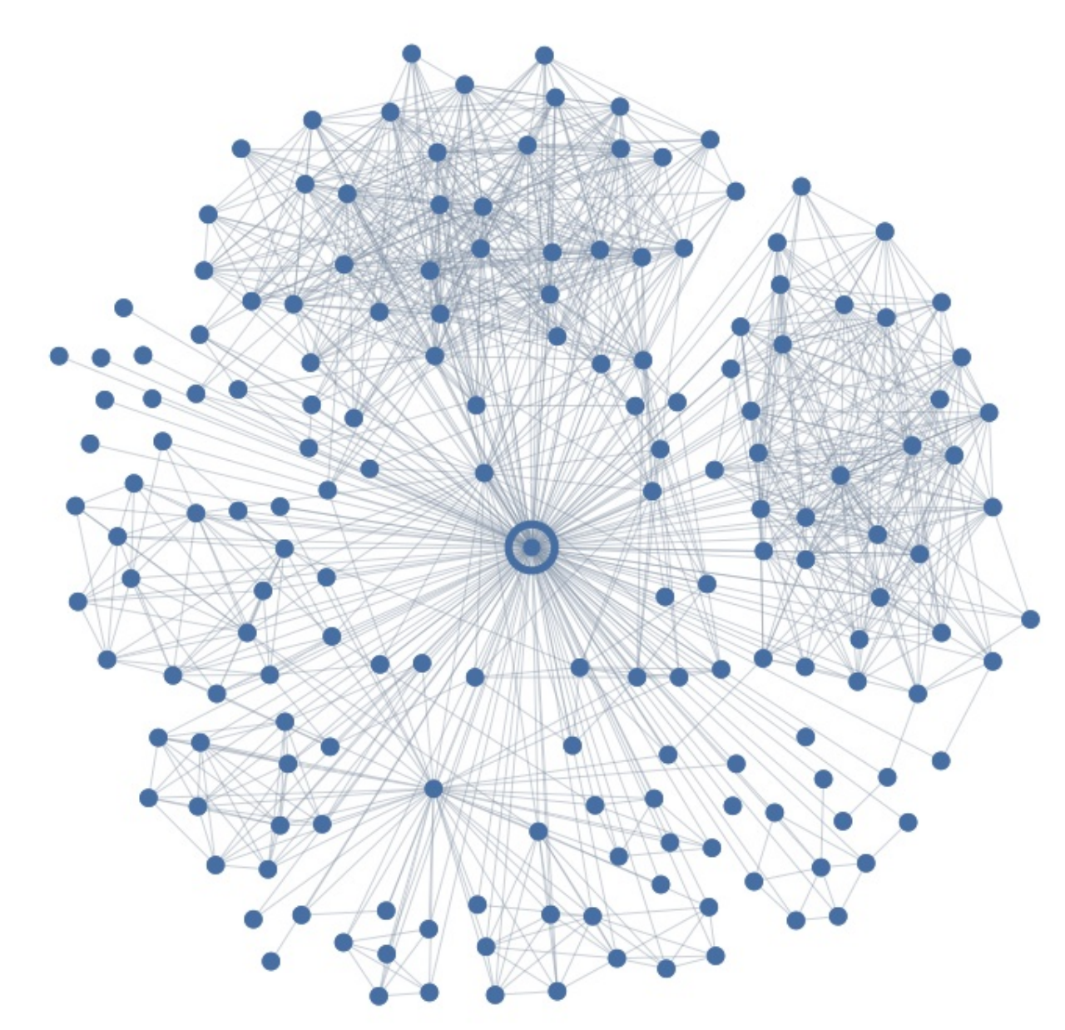
Who Do You Love?
Mutual
Friends
Testee
Your significant other
376
You

Slide 46
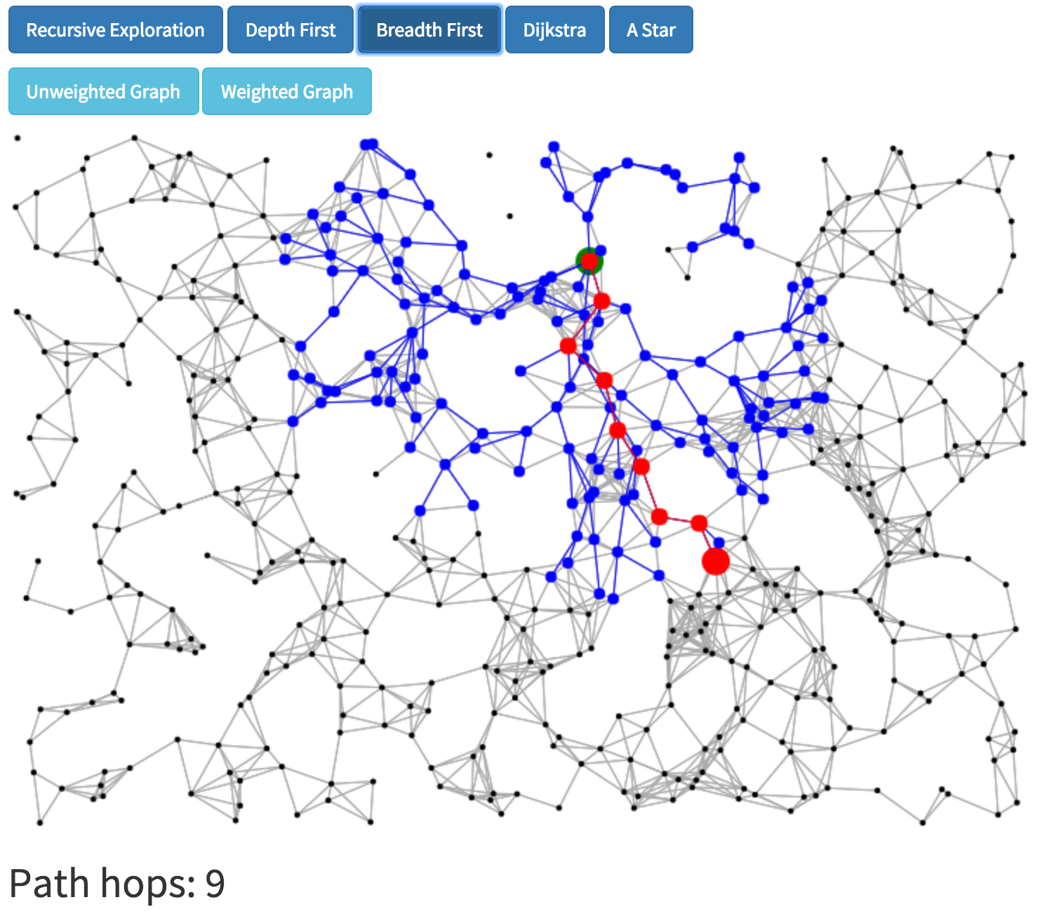
Search

Slide 47
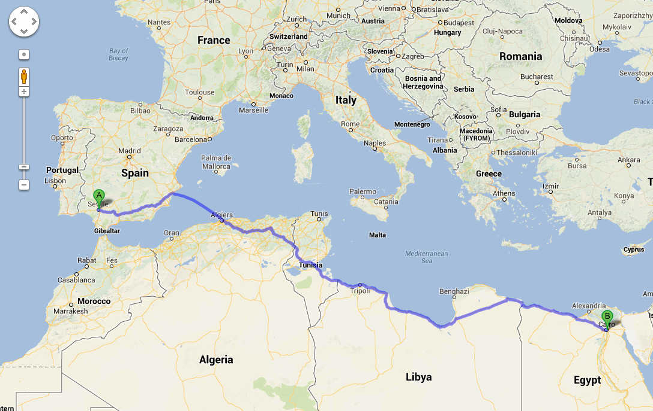
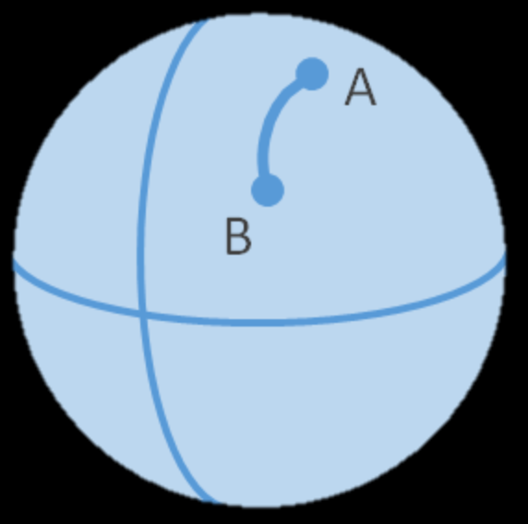
Search is Important
Google Maps

Slide 48
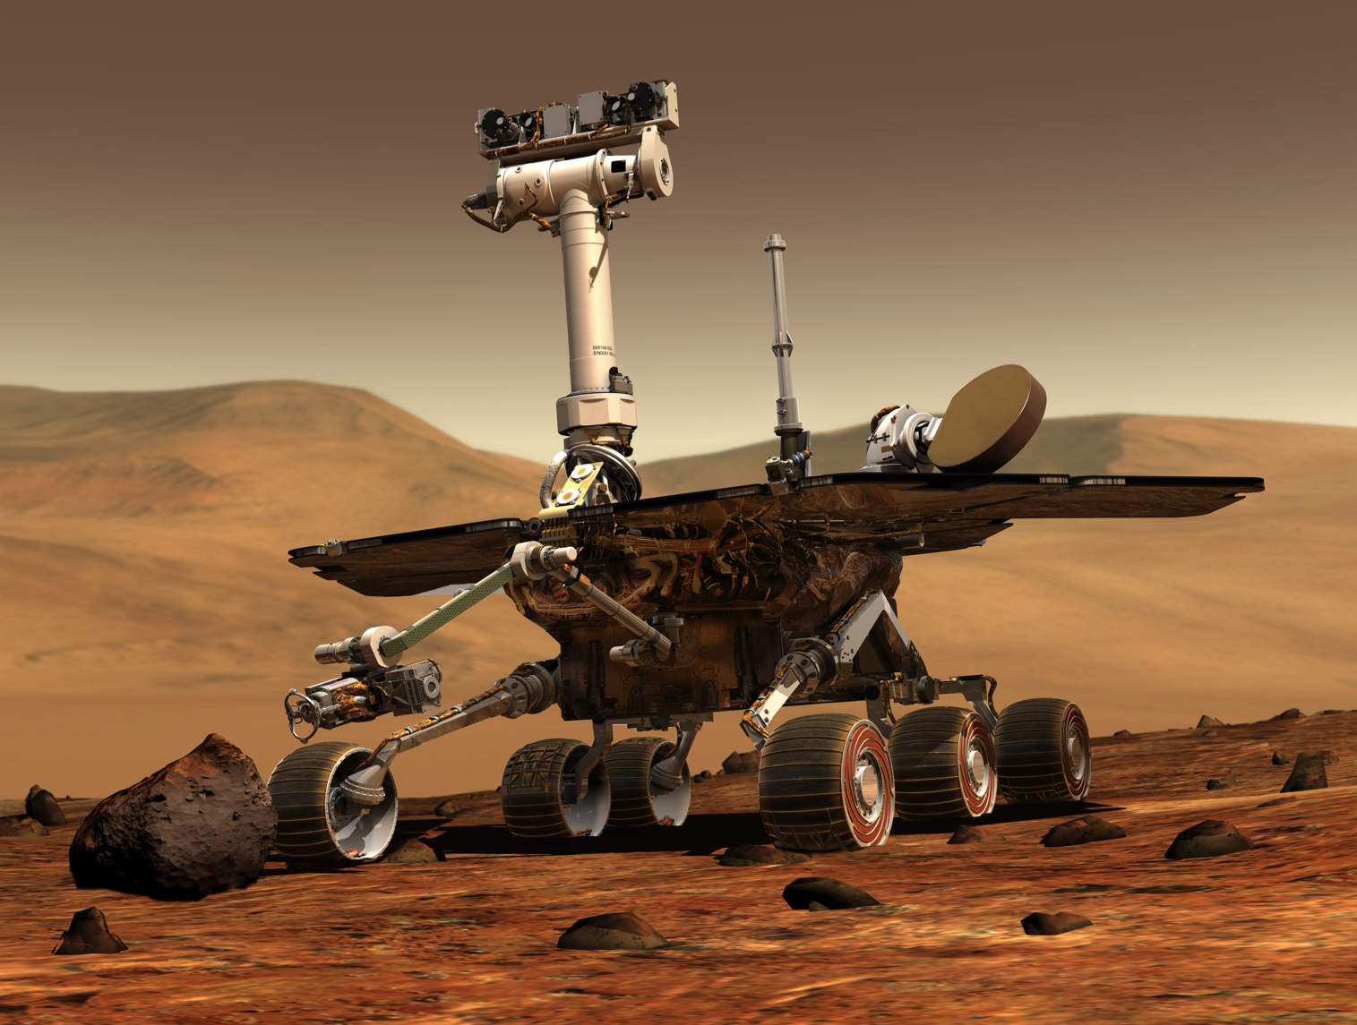
Robot Pathfinding
Trailblazer

Slide 49
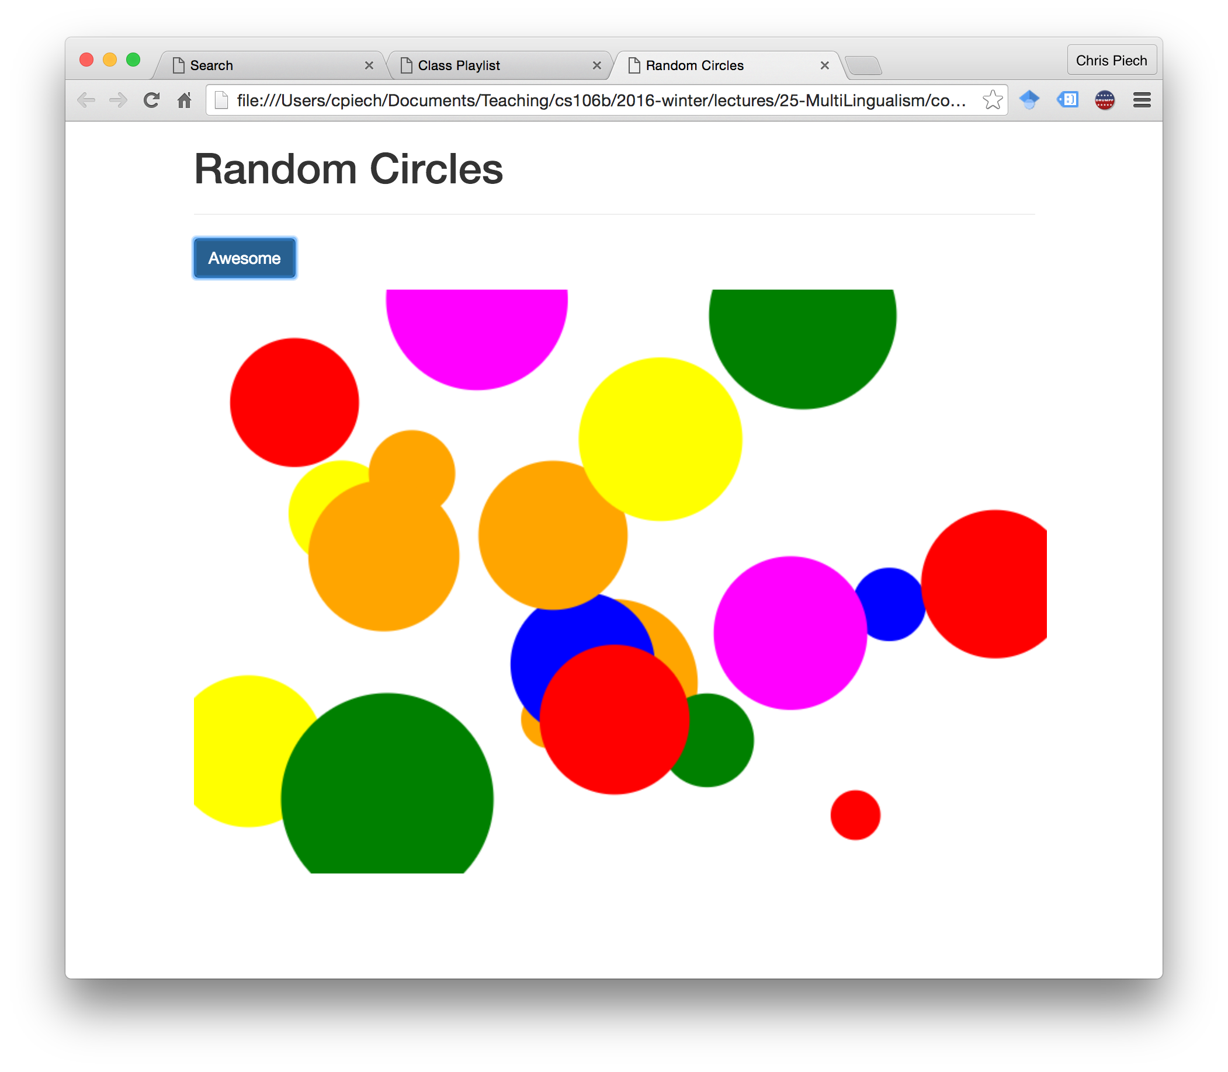
JavaScript

Slide 50

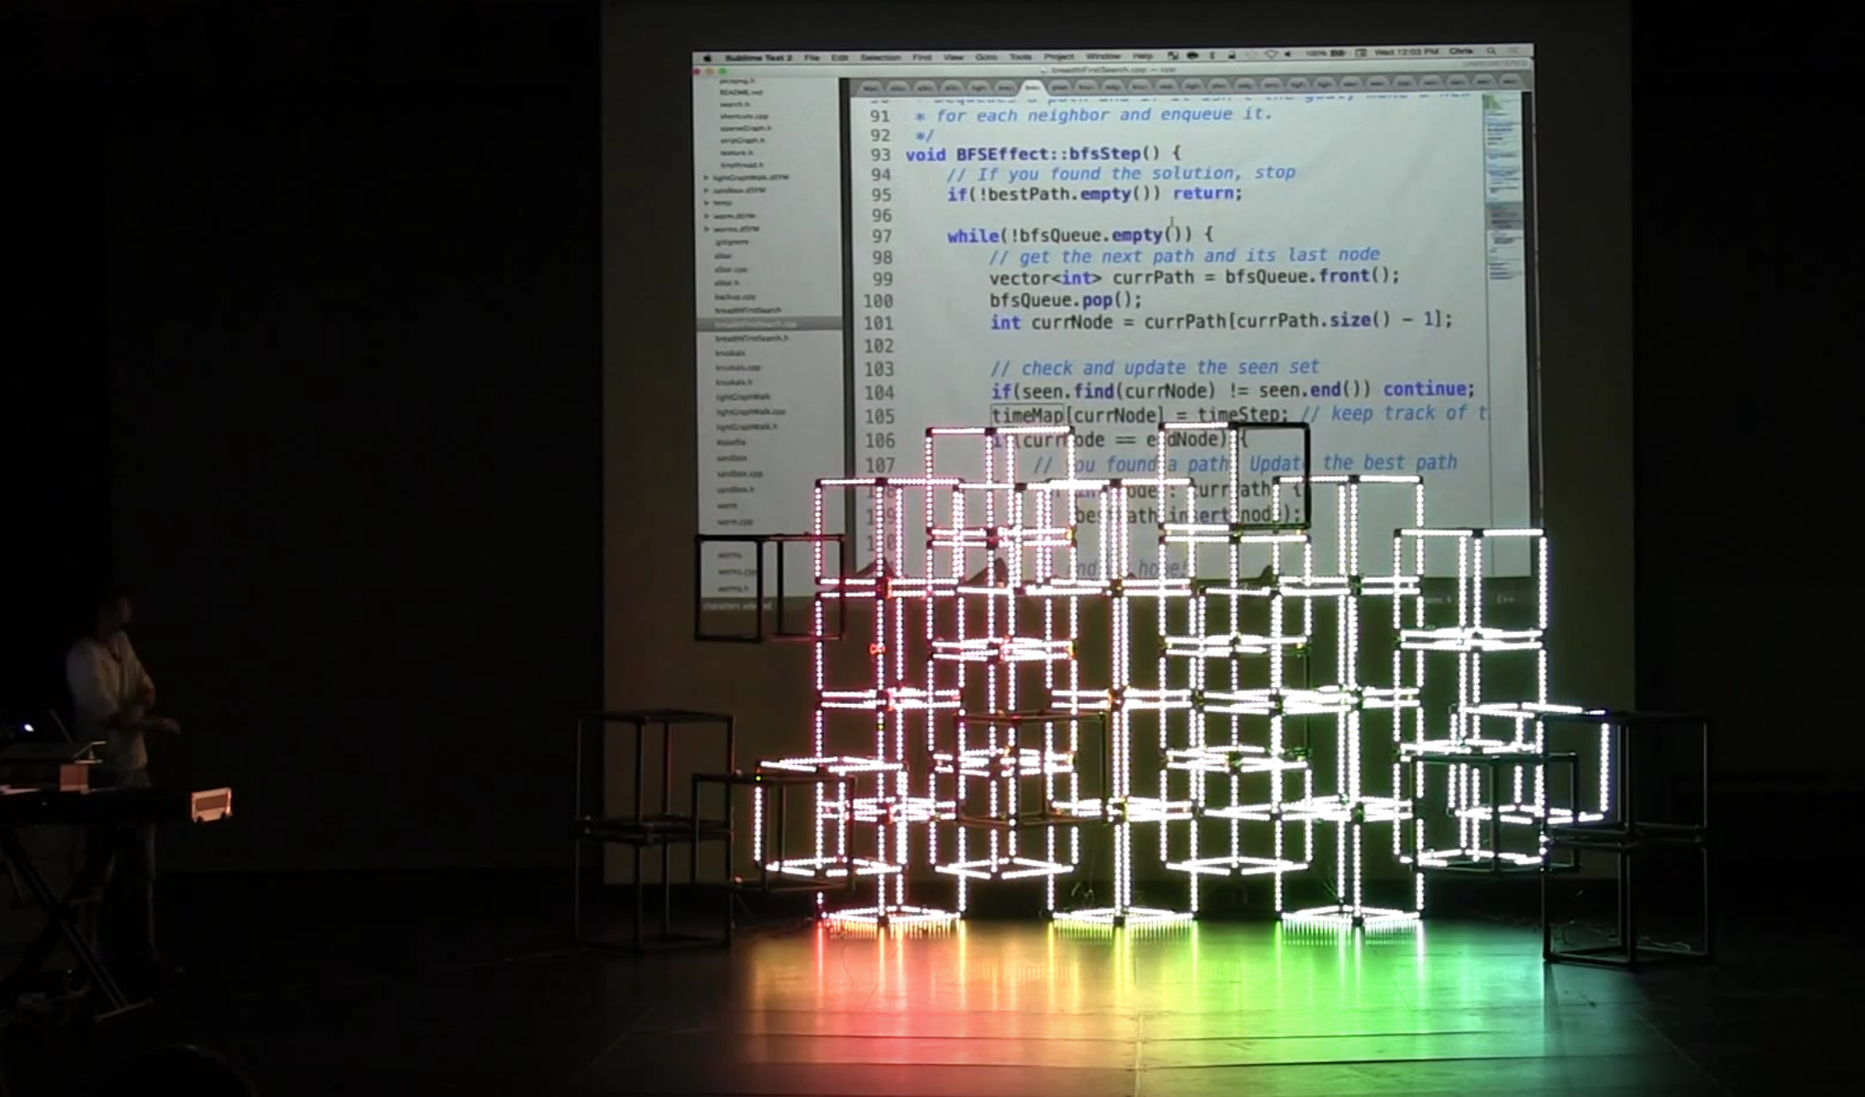
C++ For Art
Notes:
MARKET SIZE
PURPOSE: The market for lighting in live shows is huge and growing
QUESTION: What is the market opportunity?

Slide 51
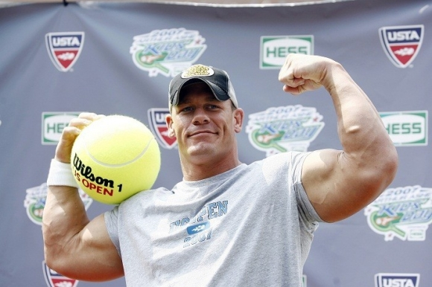
John Cena

Slide 52
End Montage

Slide 53
Overview
Functions
Use of Collections
Recursion
Recursive Exploration
Big O
Pointers
Classes and Structs
Linked Lists
Hashing
Trees
Under the Hood
Binary Search Trees
Graphs
Graph Search

Slide 54
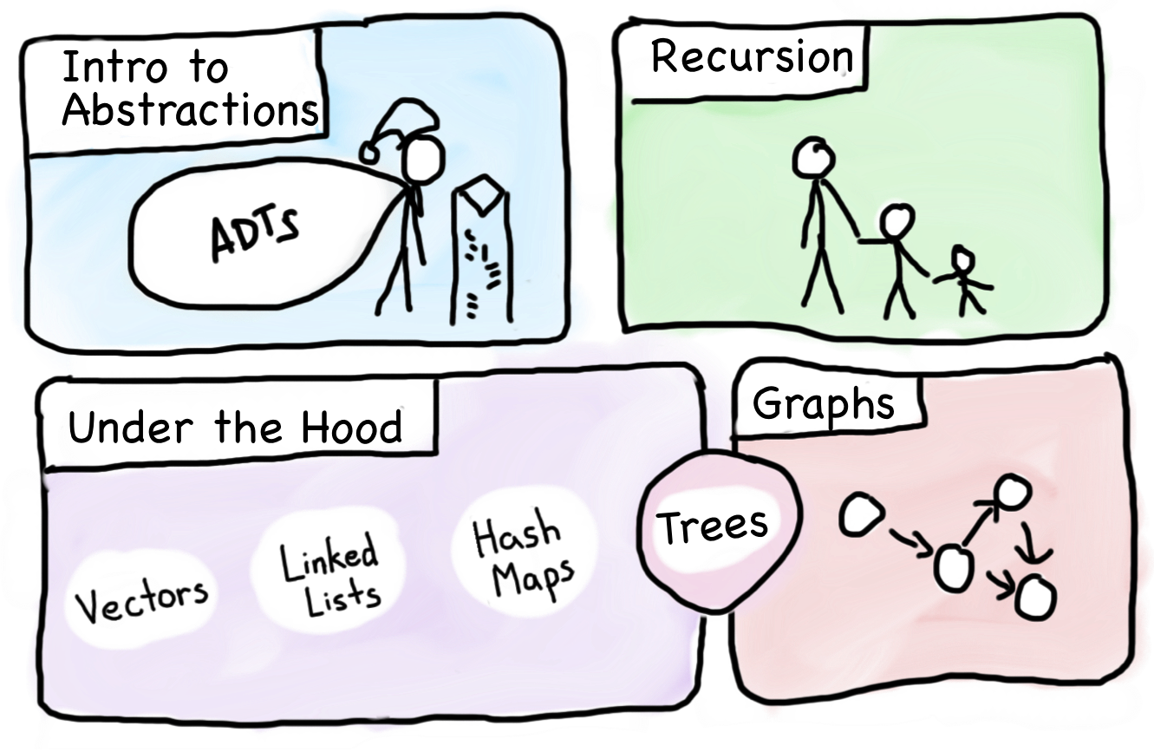
Overview

Slide 55
Goals for the Course
Learn how to model and solve complex problems with computers.
To that end:
Explore common abstractions for representing problems.
Harness recursion and understand how to think about problems recursively.
Learn and analyze different approaches for solving problems.

Slide 56
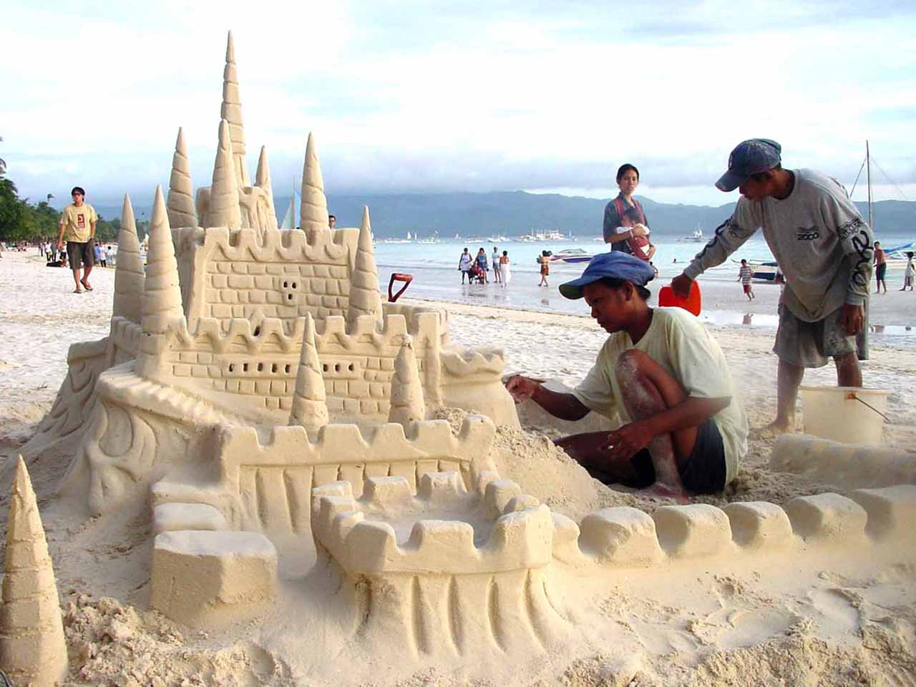
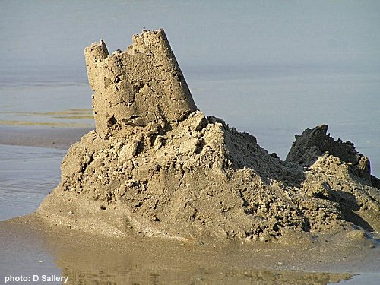
Why CS?

Slide 57

Why CS?

Slide 58
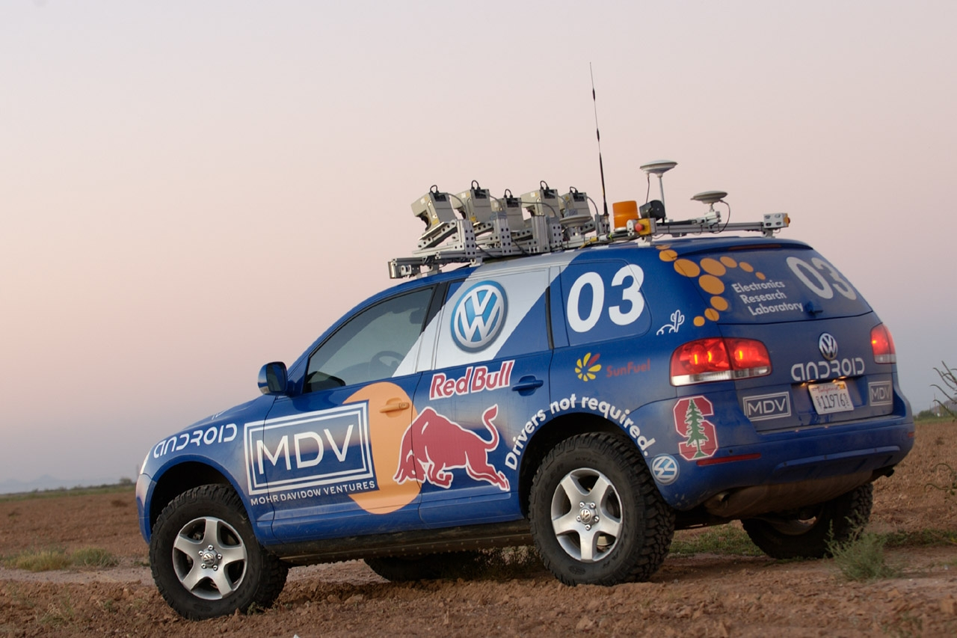
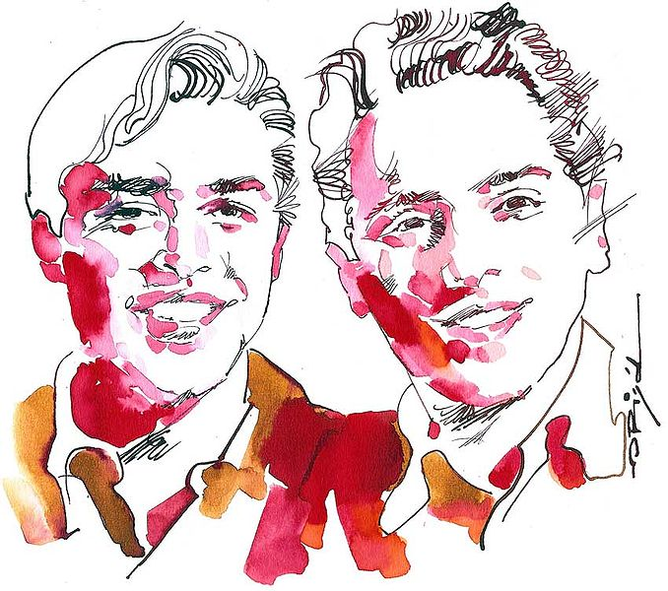
Why CS?

Slide 59
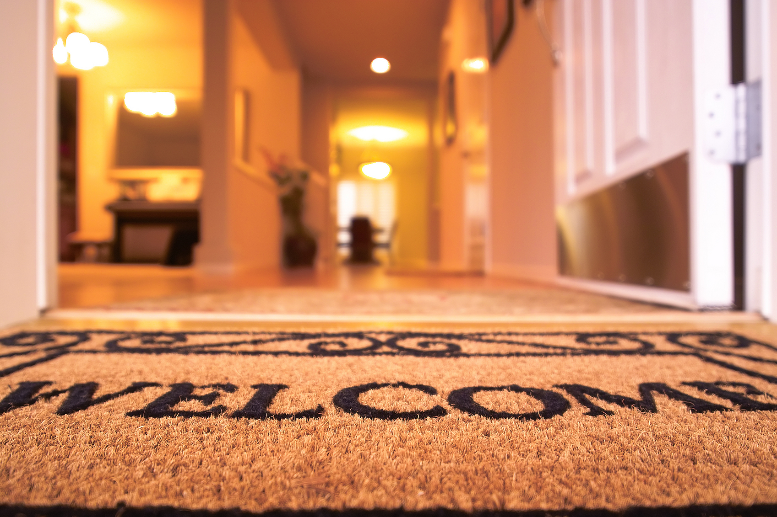
Why CS?

Slide 60
Where to Next?

Slide 61
CS Core
CS 106B
Programming Abstractions
CS 103
Mathematical Foundations
of Computing
CS 107
Computer Organization
and Systems
CS 109
Introduction to Probability
for Computer Scientists
CS 110
Principles of
Computer Systems
CS 161
Design and Analysis
of Algorithms

Slide 62

CS Core
CS 106B
Programming Abstractions
CS 103
Mathematical Foundations
of Computing
CS 107
Computer Organization
and Systems
CS 109
Introduction to Probability
for Computer Scientists
CS 110
Principles of
Computer Systems
CS 161
Design and Analysis
of Algorithms

Slide 63
CS Core
CS 106B
Programming Abstractions
CS 103
Mathematical Foundations
of Computing
CS 107
Computer Organization
and Systems
CS 109
Introduction to Probability
for Computer Scientists
CS 110
Principles of
Computer Systems
CS 161
Design and Analysis
of Algorithms

Slide 64
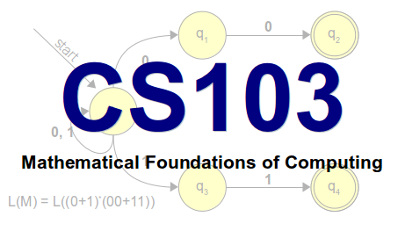
CS103
Can computers solve all problems?
Spoiler alert: no!
Why are some problems harder than others?
We can do find in an unsorted array in O(N), and we can sort an unsorted array in O(NlogN). Is sorting just inherently a harder problem, or are there better O(N) sorting algorithm yet to be discovered?
How can we be certain about this?

Slide 65
CS107 (kinda like CS106C)
How do we encode text, numbers, programs, etc. using just 0s and 1s?
Where does memory come from? How is it managed?
How do compilers, debuggers, etc. work?

Slide 66

CS107 in the News
In April 2014, security experts warned that users of thousands of major websites needed to change their passwords due to potential exposure caused by the “Heartbleed” vulnerability
Heartbleed exploited a buffer overrun bug in OpenSSL
SSL is the layer that secures web interactions, i.e., it’s what make the “s” in “https://” mean something

Slide 67
CS107 in the News
“heartbeat”
Are you still there? If you are, repeat this word back to me: "hello" [0x0005 bytes].
Each char is one byte, so 5 letters
Unfortunately, the software also let you send messages like this:
Are you still there? If you are, repeat this word back to me: "hello" [0xFFFF bytes].
That’s 65535 bytes—much more than the length of "hello”!

Slide 68
CS107 is not
CS107 is not a litmus test for whether you can be a computer scientist.
You can be a great computer scientist without enjoying low-level systems programming.
CS107 is not indicative of what programming is “really like.”
CS107 does a lot of low-level programming. You don't have to do low-level programming to be a good computer scientist.

Slide 69
False Narrative
CS106A
Fun
Effort

Slide 70
False Narrative
CS106A
CS106B
Fun
Effort

Slide 71
False Narrative
CS106A
CS106B
Fun
CS107
Effort

Slide 72
False Narrative
CS106A
CS106B
Fun
CS107
Effort

Slide 73
False Narrative
CS106A
CS106B
Fun
CS107
Effort

Slide 74
False Narrative
HCI
Graphics
CS106A
AI
Hum Bio
CS106B
Fun
CS107
Systems
Effort

Slide 75

CS107E
CS107E
Computer Systems from the Ground Up
Pat Hanrahan
Dawson Engler
Julie Zelenski

Slide 76


CS109
Foundations of
probability
Narrative driven
Intro to
Machine Learning

Slide 77
Other CS Courses

Slide 78
CS9
1 unit, 1 meeting per week, little to no outside work
Prereq: 106B/X
Practice real job interview questions
Additional topics such as resume polish, negotiating once you have multiple offers, differences between roles (Project Management vs Developer vs Test Engineer)
Special guests from industry!
Taught by Cynthia Lee, Keith Schwarz
Offered each autumn quarter

Slide 79
CS181 Ethics
Modern ethics:
Edward Snowden reveals that NSA knows more about you than your parents do
GamerGate: about harassing women, or about ethics in game journalism?
How should AirBnB be taxed?
The password to launch the US nuclear arsenal was 00000000
Autonomous cars. How to value human life?
We have the power to control and create technology, but how should we use it?

Slide 80


Slide 81
CS108
How do you build large software systems in a team?
Introduction to things you need to know for work in the “real world”:
Unit-testing frameworks
Object-oriented design
Multithreaded applications
Databases and web applications
Source control

Slide 82
CS193: Language Specific Courses
Misc. offerings throughout the year, focused on specific technologies:
CS41: Python Programming
CS193A: Android Programming
CS193C: Client-Side Web Technologies
CS193I: iOS Programming
CS193L: Lua Programming
CS193P: iPhone and iPad programming
Great for learning particular technologies.
Apply at stanfordpython.com

Slide 83
Options Beside CS Major
CS Minor: only 5 more classes!
103, 107, 109, two your choice—fun!
CS Coterminal MS degree
Earn an MS in CS while you are here earning your BS
Possible for CS majors and other majors
ex: Math major, CS co-term

Slide 84
CS Major
Project
Biocomputation
AI
Graphics
Systems
HCI
Information

Slide 85
Future Chris: Say words.

Slide 86
We will die one day

Slide 87
We will die one day.
Now you are alive.

